Slide 1
Linear Programming
Linear programming is really so important?

Slide 2
A political problem
Policy | urban | suburban | rural
Build roads | -2 | 5 | 3
Gun control | 8 | 2 | -5
Farm subsidies | 0 | 0 | 10
Gasoline tax | 10 | 0 | -2

Slide 3
Let x₁ be the number of thousands of dollars spent on advertising on building roads,
x₂ is the number of thousands of dollars spent on advertising on gun control,
x₃ is the number of thousands of dollars spent on advertising on farm subsidies, and
x₄ is the number of thousands of dollars spent on advertising on a gasoline tax.

Slide 4
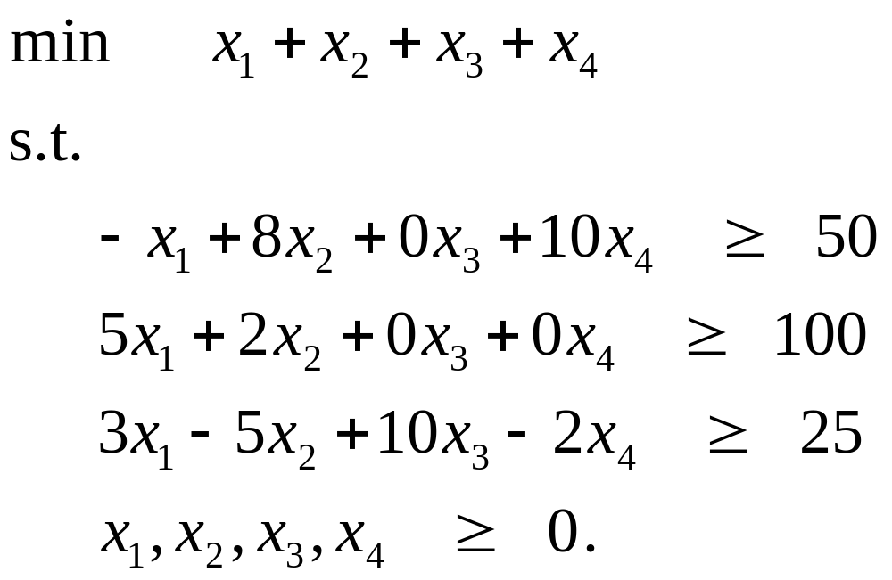

Slide 5
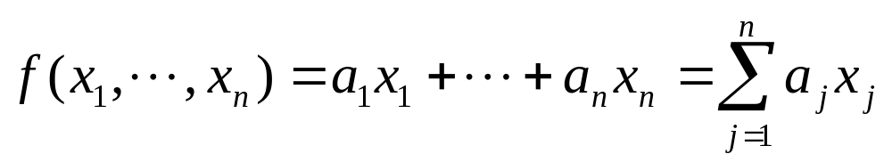
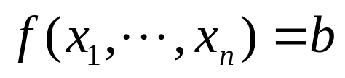
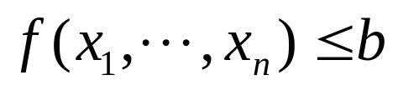
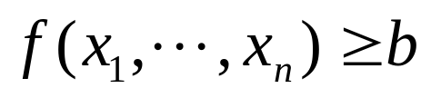
General linear programs
Given a set of real numbers a₁, a₂, ..., a_{n} and a set of variables x₁, x₂,..., x_{n}, a linear function f on those variables is defined by
linear equality:
linear inequalities:

Slide 6
Linear constraints
equalities or linear equalities.
Formally a linear-programming problem is the problem of either minimizing or maximizing a linear function subject to a finite set of linear constraints.
Minimization linear program
Maximization linear program

Slide 7
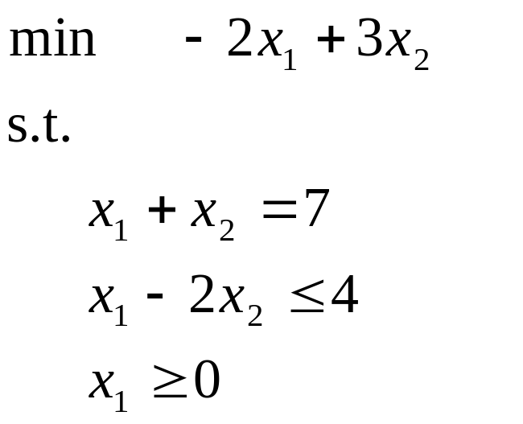
Example
Applications of linear programming
An airline wishes to schedule its flight crews.
An oil company wants to decide where to drill for oil.
Modeling and solving graph and combinatorial problems.

Slide 8
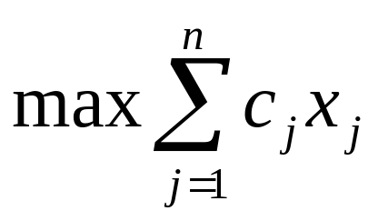
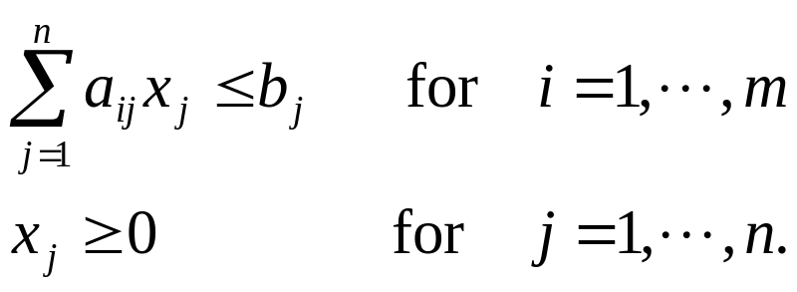
Standard forms
Given n real numbers c₁, c₂, ..., c_{n}; m real numbers b₁, b₂, ..., b_{m}; and mn real numbers a_{ij} for i = 1, 2, ..., m and j = 1, 2, ..., n. We wish to find n real numbers x₁, x₂,..., x_{n} that
Subject to

Slide 9
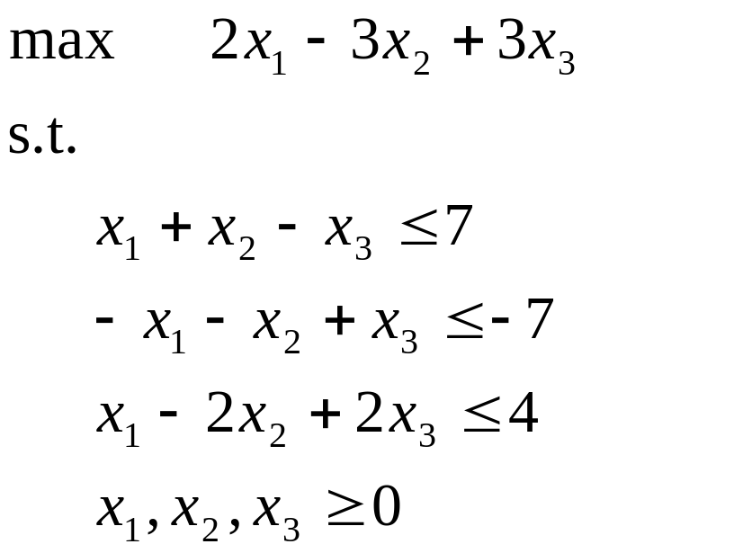
Feasible solution
Infeasible solution
Objective value
Optimal solution
Optimal objective value
Unbounded
Example

Slide 10
Converting linear programs into standard form
A linear program may not be in standard form for one of four possible reasons:
1. The objective function may be a minimization rather than a maximization.
2. There may be variables without nonnegativity constraints.
3. There may be equality constraints, which have an equal sign rather than a less-than or-equal-to sign.
4. There may be inequality constraints, but instead of having a less-than-or-equal-to sign, they have a greater-than-or-equal-to sign.

Slide 11
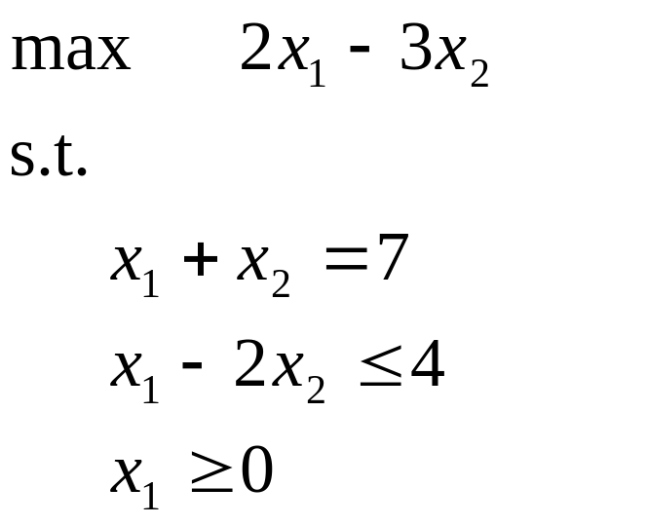
Equivalent
Step 1:Negate the coefficients in the objective function.

Slide 12
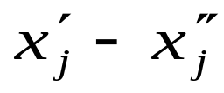
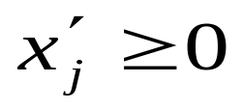
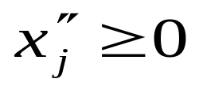
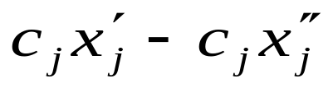
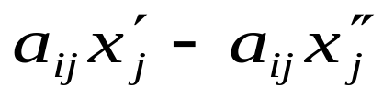
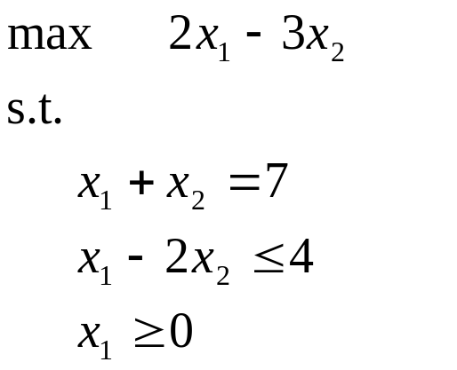
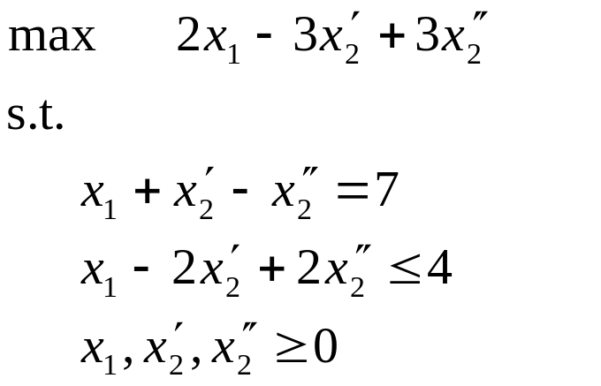
Suppose that some variable x_{j} does not have a nonnegativity constraint. Then we replace each occurrence of x_{j} by , and add the non-negativity constraints and . Thus, if the objective function has a term c_{j}x_{j} , it is replaced by , and if constraint i has a term a_{ij}x_{j}, it is replaced by .
Step 2:Convert a linear program as mentioned above.

Slide 13
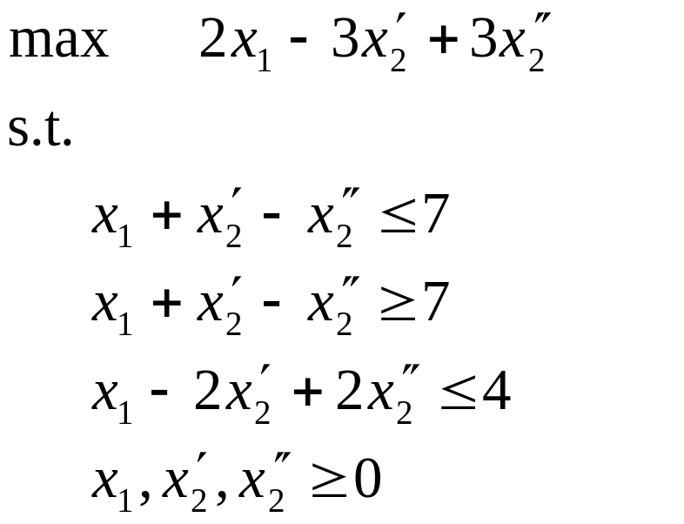
Step 3:Convert equality constraints into inequality constraints.
Suppose that a linear program has an equality constraint f (x₁, x₂, ..., x_{n}) = b. Since x = y if and only if both x ≥ y and x ≤ y, we can replace this equality constraint by the pair of inequality constraints f (x₁, x₂, ..., x_{n}) ≤ b and f (x₁, x₂, ..., x_{n})≥ b.

Slide 14
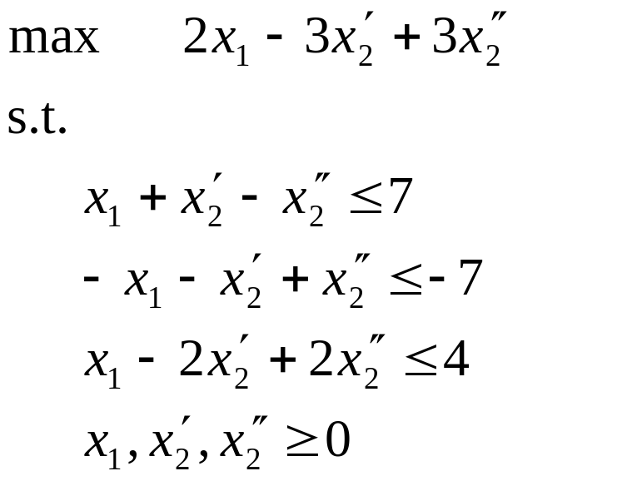
Step 4:Convert the greater-than-or-equal-to constraints to less-than-or-equal constraints by multiplying these constraints through by -1.

Slide 15
Converting linear programs into slack form
To efficiently solve a linear program with the simplex algorithm, we prefer to express it in a form in which some of the constraints are equality constraints. More precisely, we shall convert it into a form in which the nonnegativity constraints are the only inequality constraints, and the remaining constraints are equalities.

Slide 16
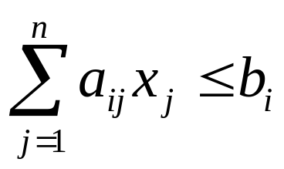
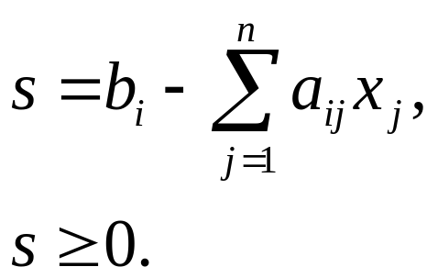
Let
be an inequality constraint. We introduce a new variable s and rewrite it
s is a slack variable because it measures the slack, or difference.

Slide 17
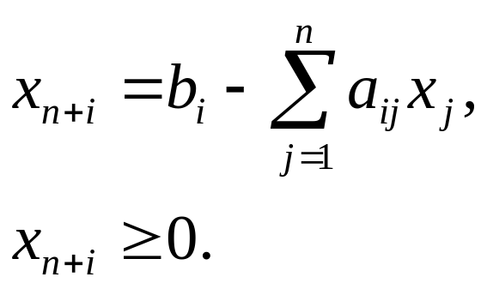
When converting from standard to slack form, we shall use x_{n+i} (instead of s) to denote the slack variable associated with the ith inequality. The ith constraint is therefore

Slide 18
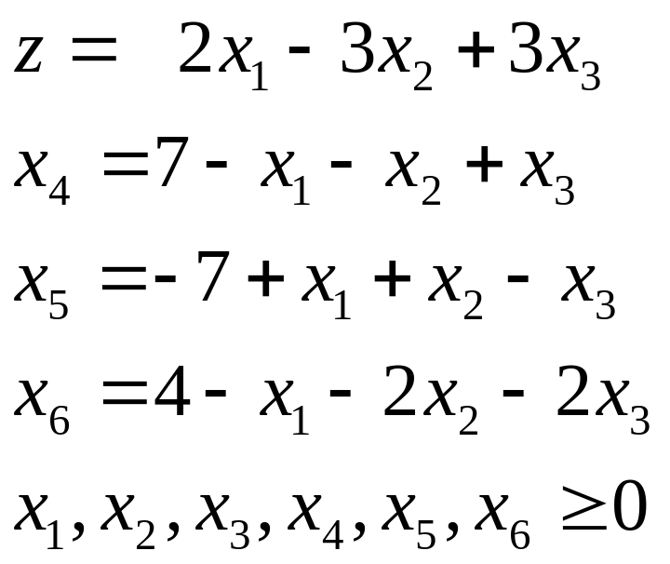
Example
Standard forms
Slack forms

Slide 19
Basic variables
The variables on the left-hand side of the equalities.
Nonbasic variables
Slack form

Slide 20
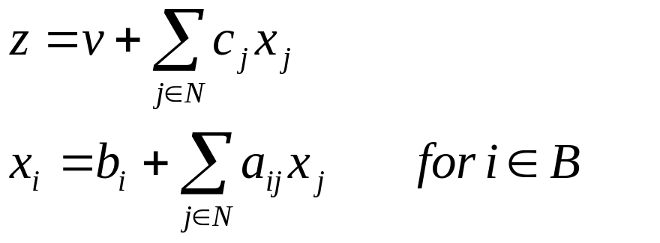
Let N denote the set of indices of the nonbasic variables and B denote the set of indices of the basic variables. |N|= n, |B| = m, and N∪B = {1, 2, ..., n + m}. The equations will be indexed by the entries of B,and the variables on the right-hand sides will be indexed by the entries of N. b_{i} , c_{j} , and a_{ij} denote constant terms and coefficients. v denote an optional constant term in the objective function. Thus we can concisely define a slack form by a tuple (N, B, A, b, c, v), denoting the slack form

Slide 21
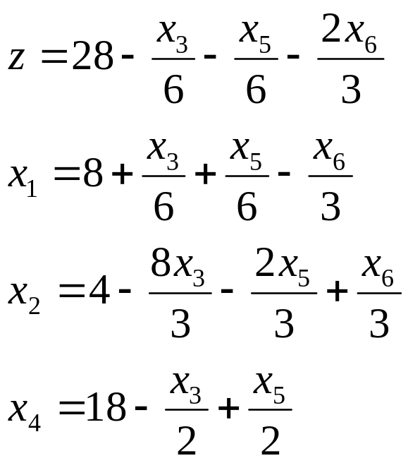
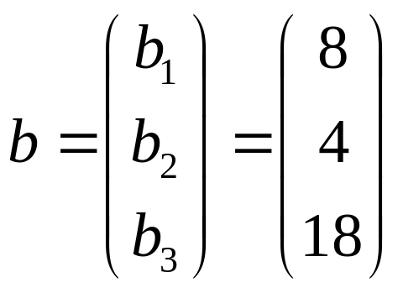
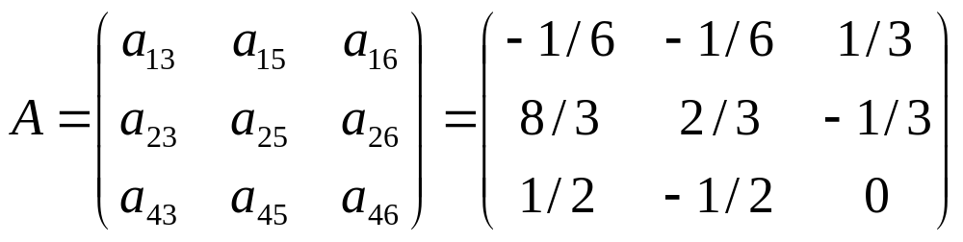
B={1,2,4}, N={3,5,6}

Slide 22
A large variety of Simplex-based algorithms exist to solve LP problems.
Other (polynomial time) algorithms have been developed for solving LP problems:
  Khachian algorithm (1979)
  Kamarkar algorithm (AT&T Bell Labs, mid 80s)
But,
none of these algorithms have been able to beat Simplex in actual practical applications.
HENCE,
Simplex (in its various forms) is and will most likely remain the most dominant LP algorithm for at least the near future

Slide 23
The simplex algorithm
"basic solution"
Set each nonbasic variable to 0, and compute the values of the basic variables from the equality constraints.
Iteration:converts one slack form into an equivalent slack form.
To achieve this increase in the objective value, we choose a nonbasic variable such that if we were to increase that variable's value from 0, then the objective value would increase too.
The slack variables explicitly maintain how far each constraint is from being tight, and so they help to determine how much we can increase values of nonbasic values without violating any constraints.

Slide 24
Basic feasible solution
Our goal, in each iteration, is to reformulate the linear program so that the basic solution has a greater objective value. We select a nonbasic variable x_{e} whose coefficient in the objective function is positive, and we increase the value of x_{e} as much as possible without violating any of the constraints.
Entering variable: a nonbasic variable
Leaving variable: a basic variable

Slide 25
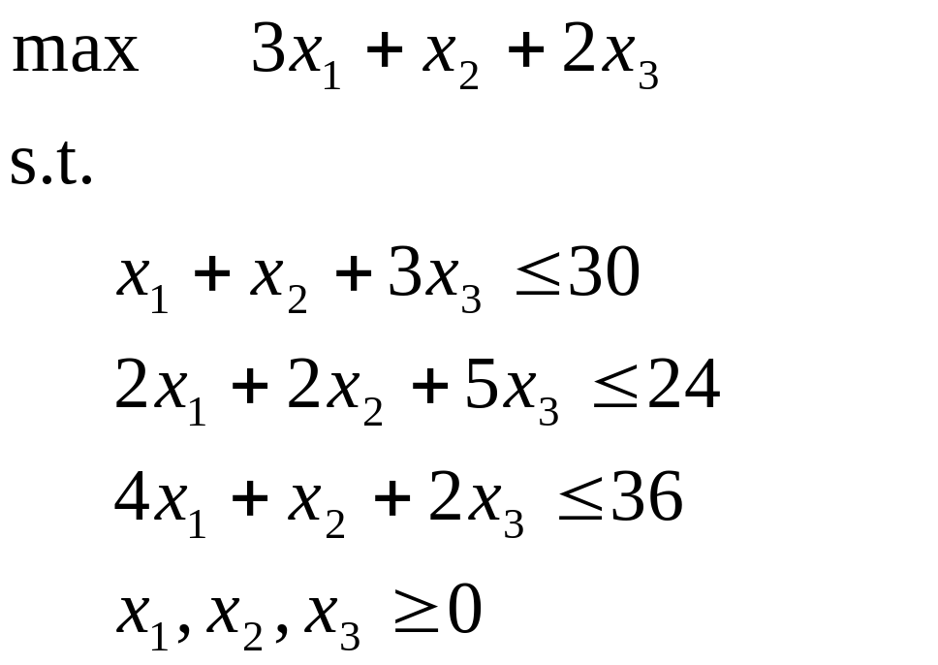
An example of the simplex algorithm
Consider the following linear program in standard form:

Slide 26
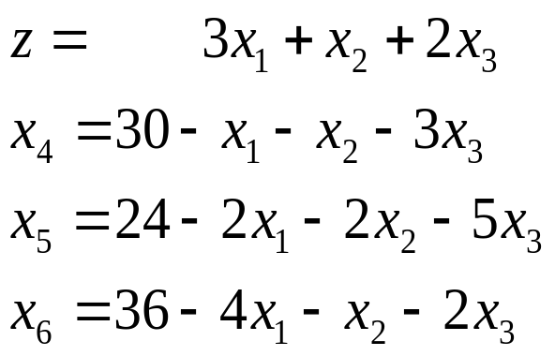
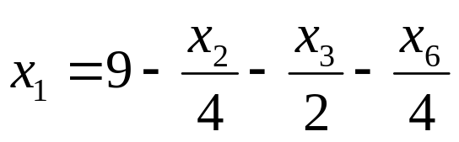
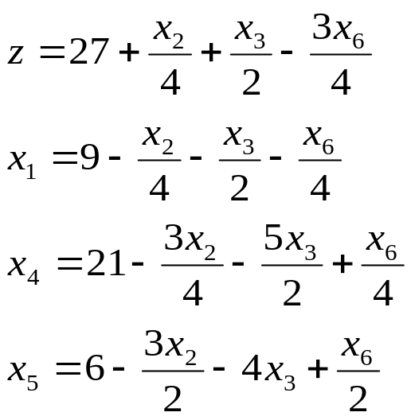
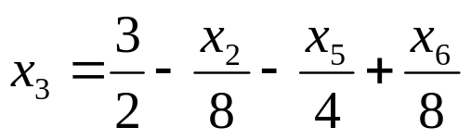
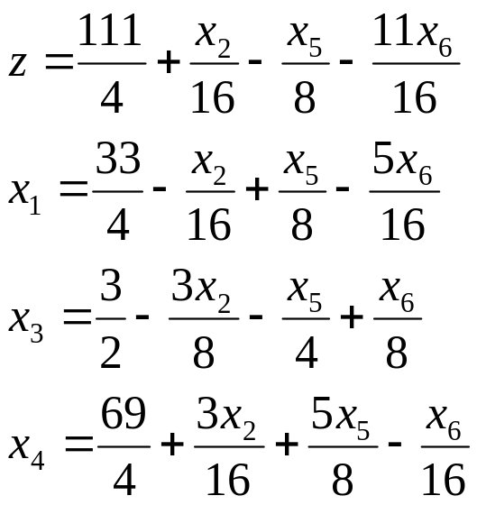
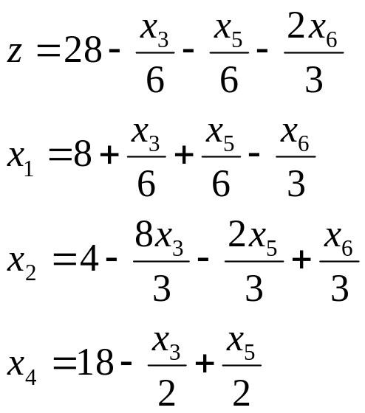
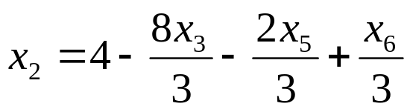
(0,0,0,30,24,36),z=0
(9,0,0,21,6,0),z=27
(33/4,0,3/2,69/4,0,0),z=111/4
(8,4,0,18,0,0),z=28

Slide 27
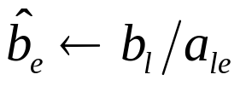


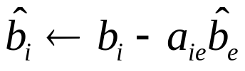


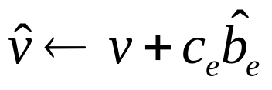
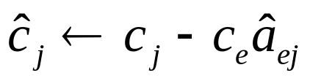
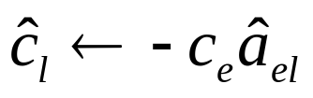


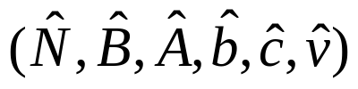
PIVOT(N, B, A, b, c, v, l, e)
1
2 for each j∈N - {e} do
3
4 for each i∈B - {l} do
5 for each j∈N - {e} do
6
7
8 for each j∈N - {e} do
9
10
11
12 return

Slide 28
The formal simplex algorithm
Several other issues to be addressed:
1)How do we determine if a linear program is feasible?
2)What do we do if the linear program is feasible, but the initial basic solution is not feasible?
3)How do we determine if a linear program is unbounded?
4)How do we choose the entering and leaving variables?

Slide 29
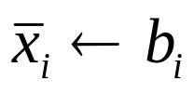

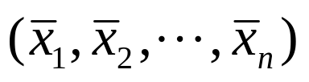
Simplex(A, b, c)
1 (N, B, A, b, c, v) ← InitializeSimplex(A, b, c)
2 while some index j∈N has c_{j} > 0 do
3 choose an index e∈N for which c_{e} > 0
4 for each index i∈B do
5 if a_{ie} > 0 then Δ_{i} ← b_{i}/a_{ie}
6 else Δ_{i} ← ∞
7 choose an index l∈B that minimizes Δ_{i}
8 if Δ_{l} = ∞ then return "unbounded"
9 else (N, B, A, b, c, v) ← PIVOT(N, B, A, b, c, v, l, e)
10 for i ← 1 to n do
11 if i∈B then
12 else
13 return

Slide 30
InitializeSimplex(A, b, c) that takes as input a linear program in standard form, that is, an m × n matrix A = (a_{ij}), an m-dimensional vector b = (b_{i}), and an n dimensional vector c = (c_{j}). If the problem is infeasible, it returns a message that the program is infeasible and then terminates. Otherwise, it returns a slack form for which the initial basic solution is feasible.

Slide 31
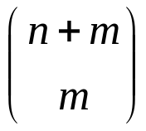
Lemma
If SIMPLEX fails to terminate in at most iterations , then it cycles.
The ways of avoiding cycles:
1)Perturb the input slightly so that it is impossible to have two solutions with the same objective value;
2)Break ties lexicographically;
3)Break ties by always choosing the variable with the smallest index.

Slide 32
Homework
Page from 192 to193
  1.Each group must finish the corresponding exercises
  2.Each group must finish the corresponding experiments

